Slide 1
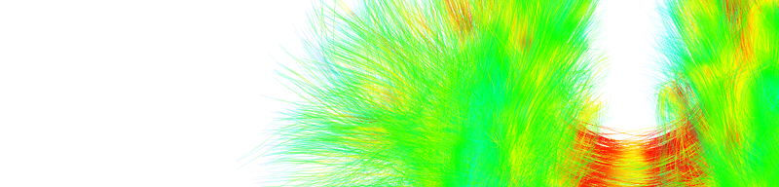
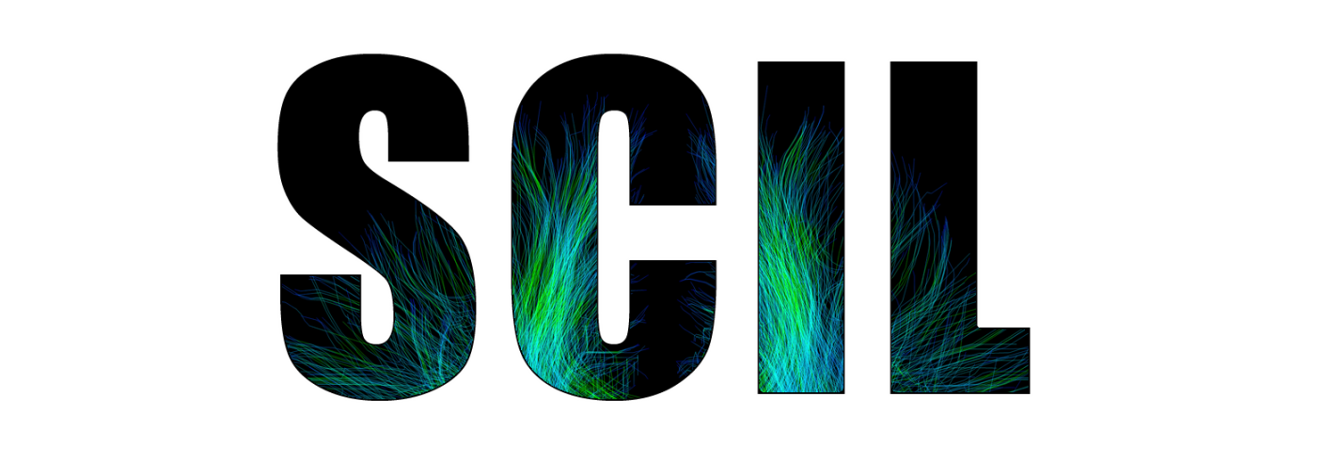


Diffusion
Tractography
Eleftherios Garyfallidis, Ph.D.
Diffusion Imaging in Python
http://dipy.org
Sherbrooke Connectivity Imaging
Laboratory (SCIL)
http://scil.dinf.usherbrooke.ca
Notes:
Merci Gilles Kahn

Slide 2
Basic principles

Slide 3
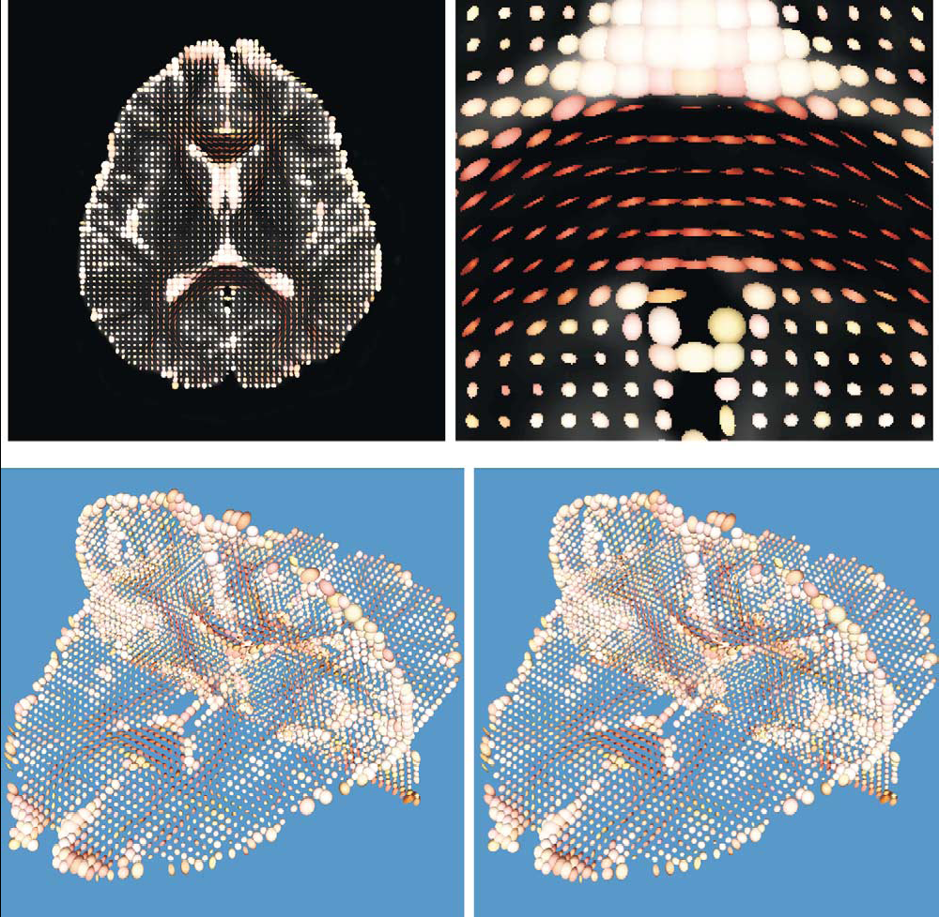
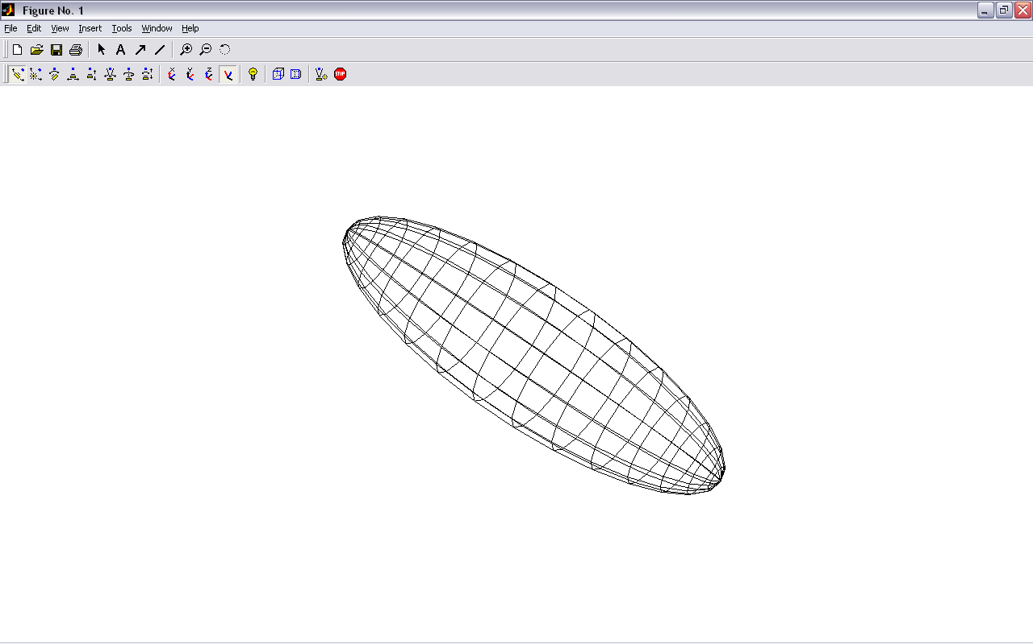
Main idea: Tensor-based tracking
z
v₁
λ₁
v₂
v₃
x
Y.Masutani et al.” European Journal of Radiology 46 (2003)

Slide 4
Connect the main directions voxel to voxel
z
v₁
λ₁
v₂
v₃
x

Slide 5
Deterministic tracking
If we assume the main eigenvector is tangential to the underlying trajectory of the white matter
Starting from a seed point we can propagate a 3D curve that represents the WM pathway
v₁
Two main approaches :
FACT - (Mori et al 1999)
Interpolated Streamlines (Euler, RK, etc) - (Basser et al. 2000)
Streamline Tractography
Seed Point

Slide 6
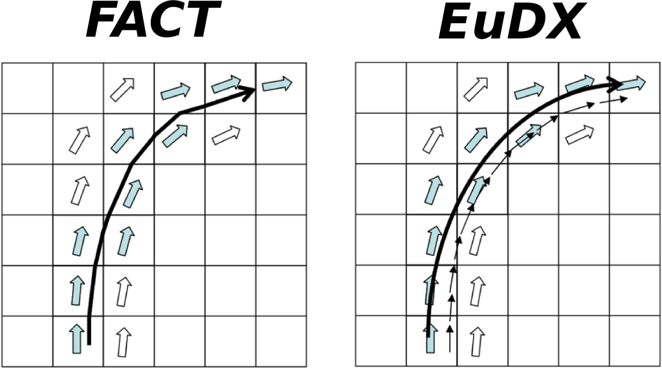

Deterministic tracking
FACT Interpolated
The track follows a path parallel to the principal eigenvector until the border of the voxel.
The step size is not fixed
Works well with low curvature regions
FACT is used in DTI-Studio and TrackVis
At each step a new direction is interpolated taking into account the surrounding eigenvectors
Step size is fixed
Available in Dipy (Garyfallidis, Frontiers 2014)
New Position
Old Position
Step Size
Principal Eigenvector
= + x
E

Slide 7
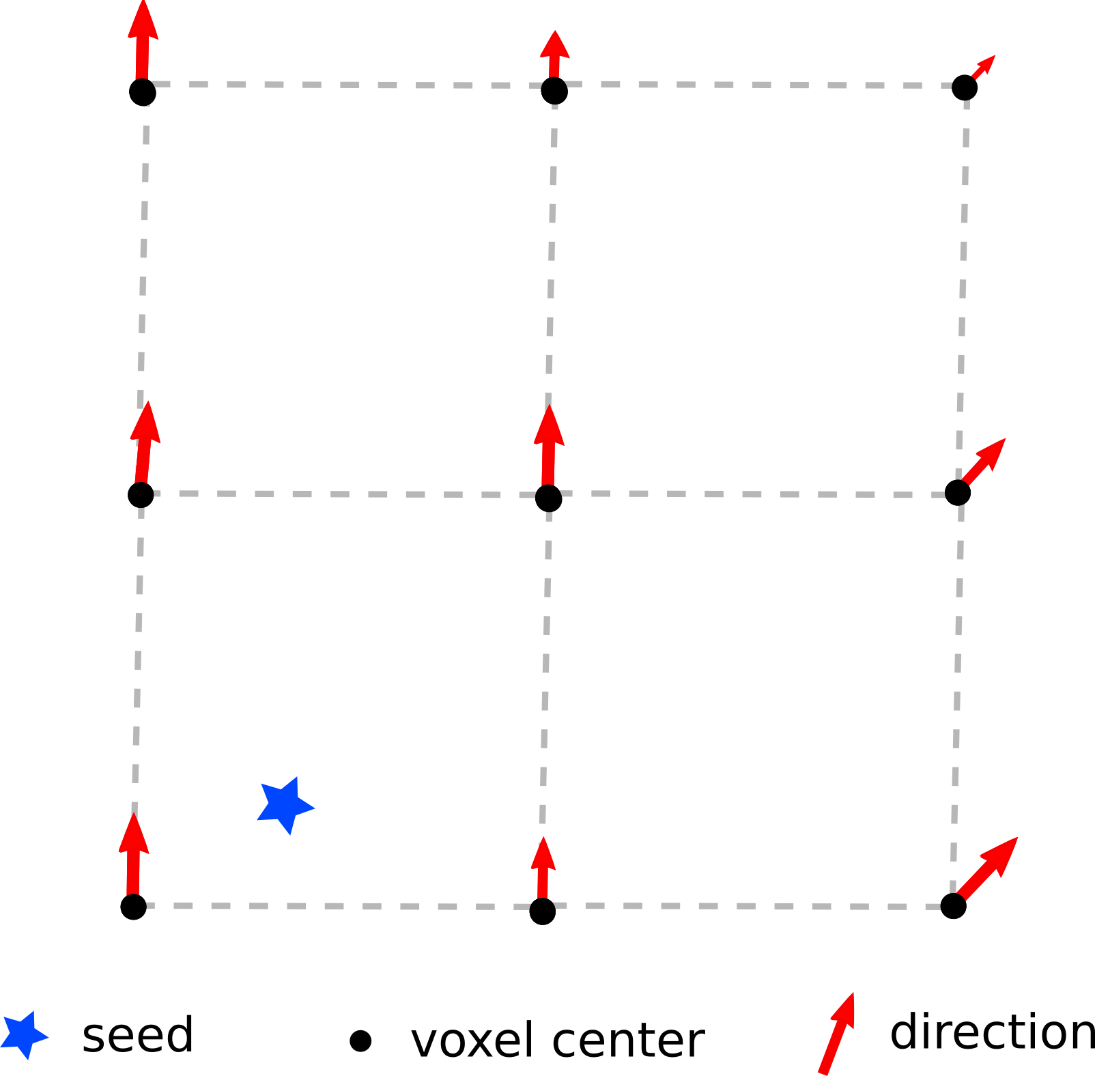
Euler Delta Crossings (EuDX)
E

Slide 8
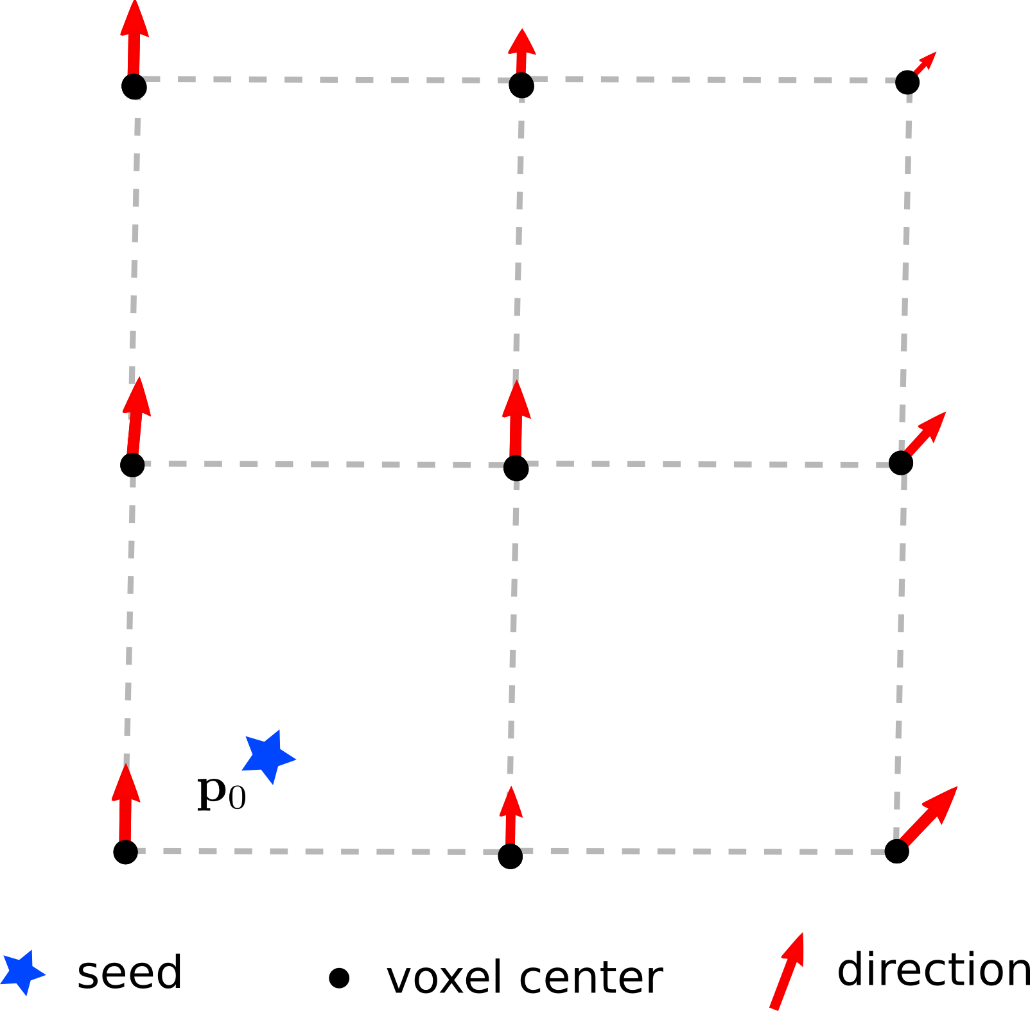
Euler Delta Crossings (EuDX)
E

Slide 9
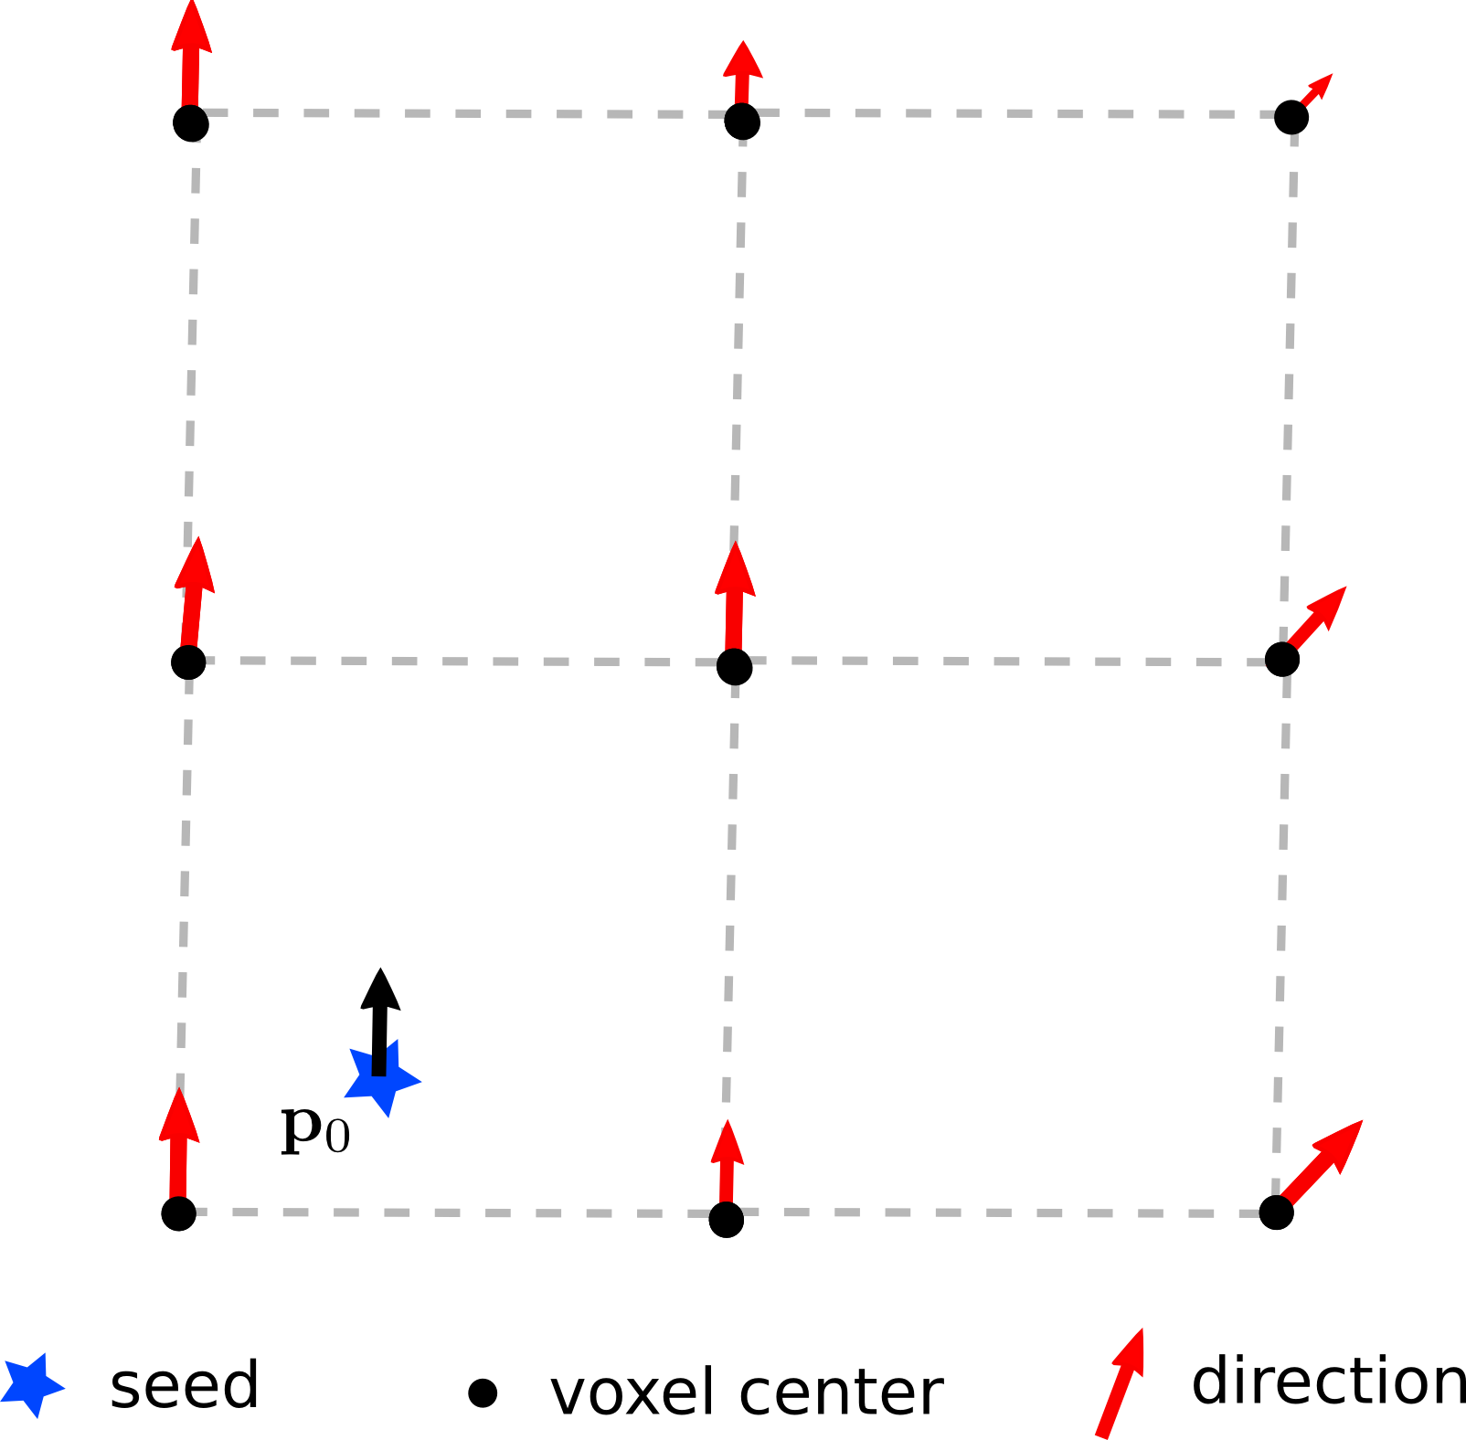
Euler Delta Crossings (EuDX)
E

Slide 10
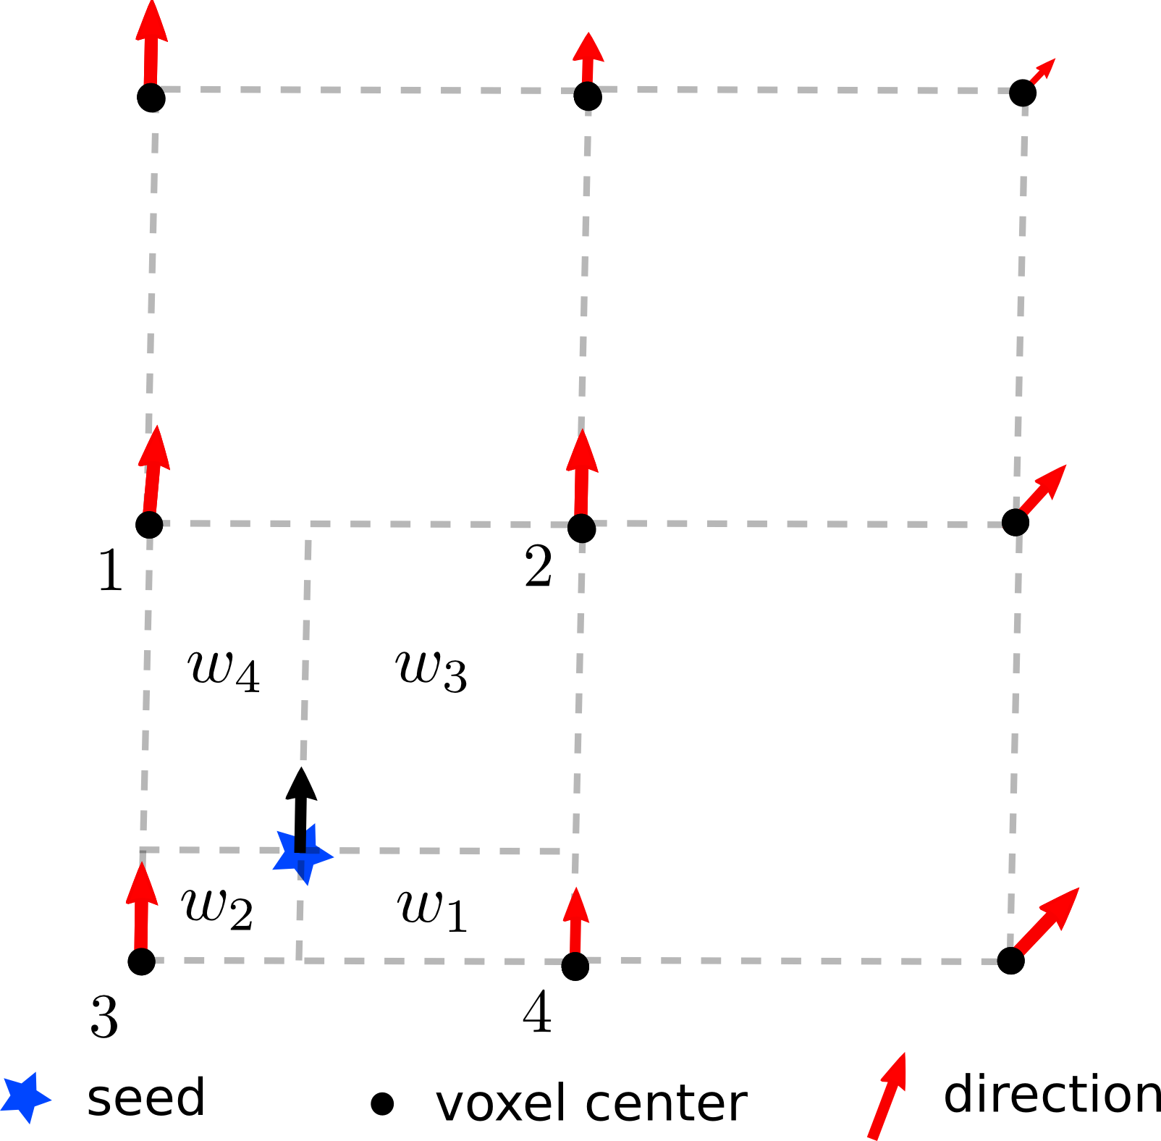
Euler Delta Crossings (EuDX)
E

Slide 11
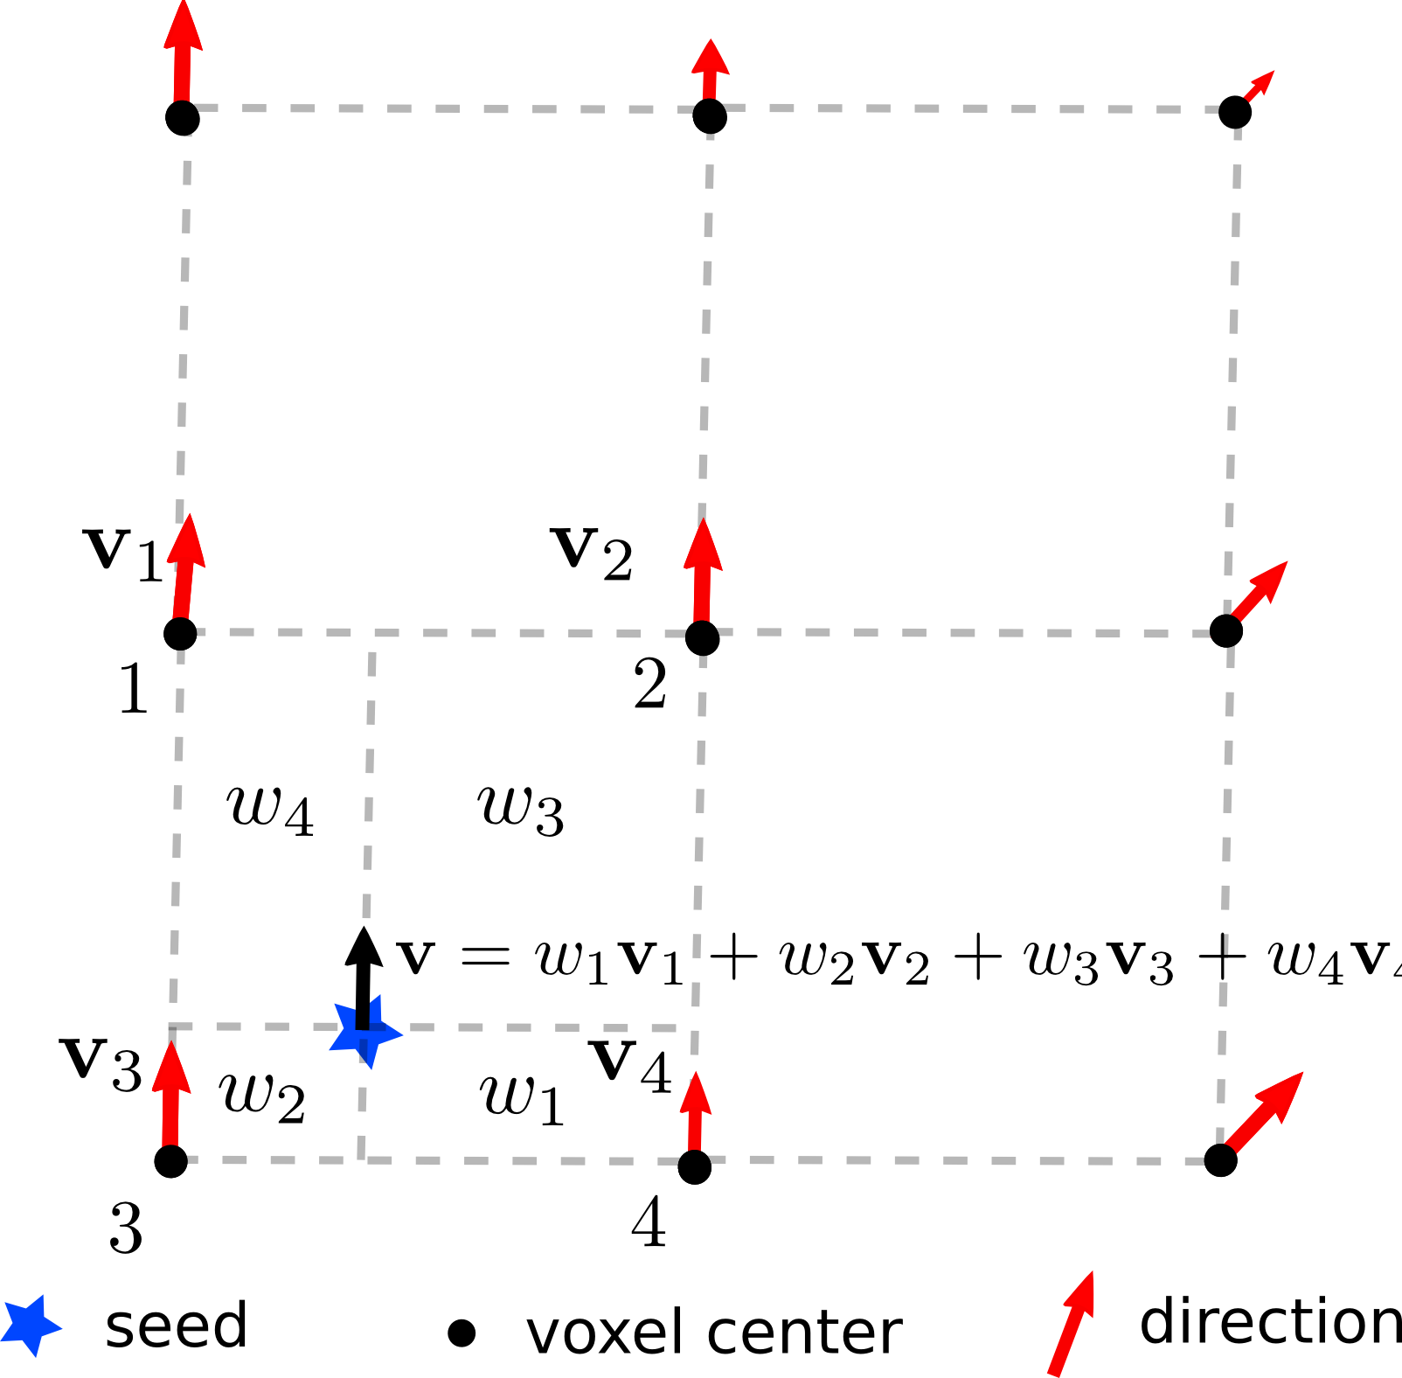
Euler Delta Crossings (EuDX)
E

Slide 12
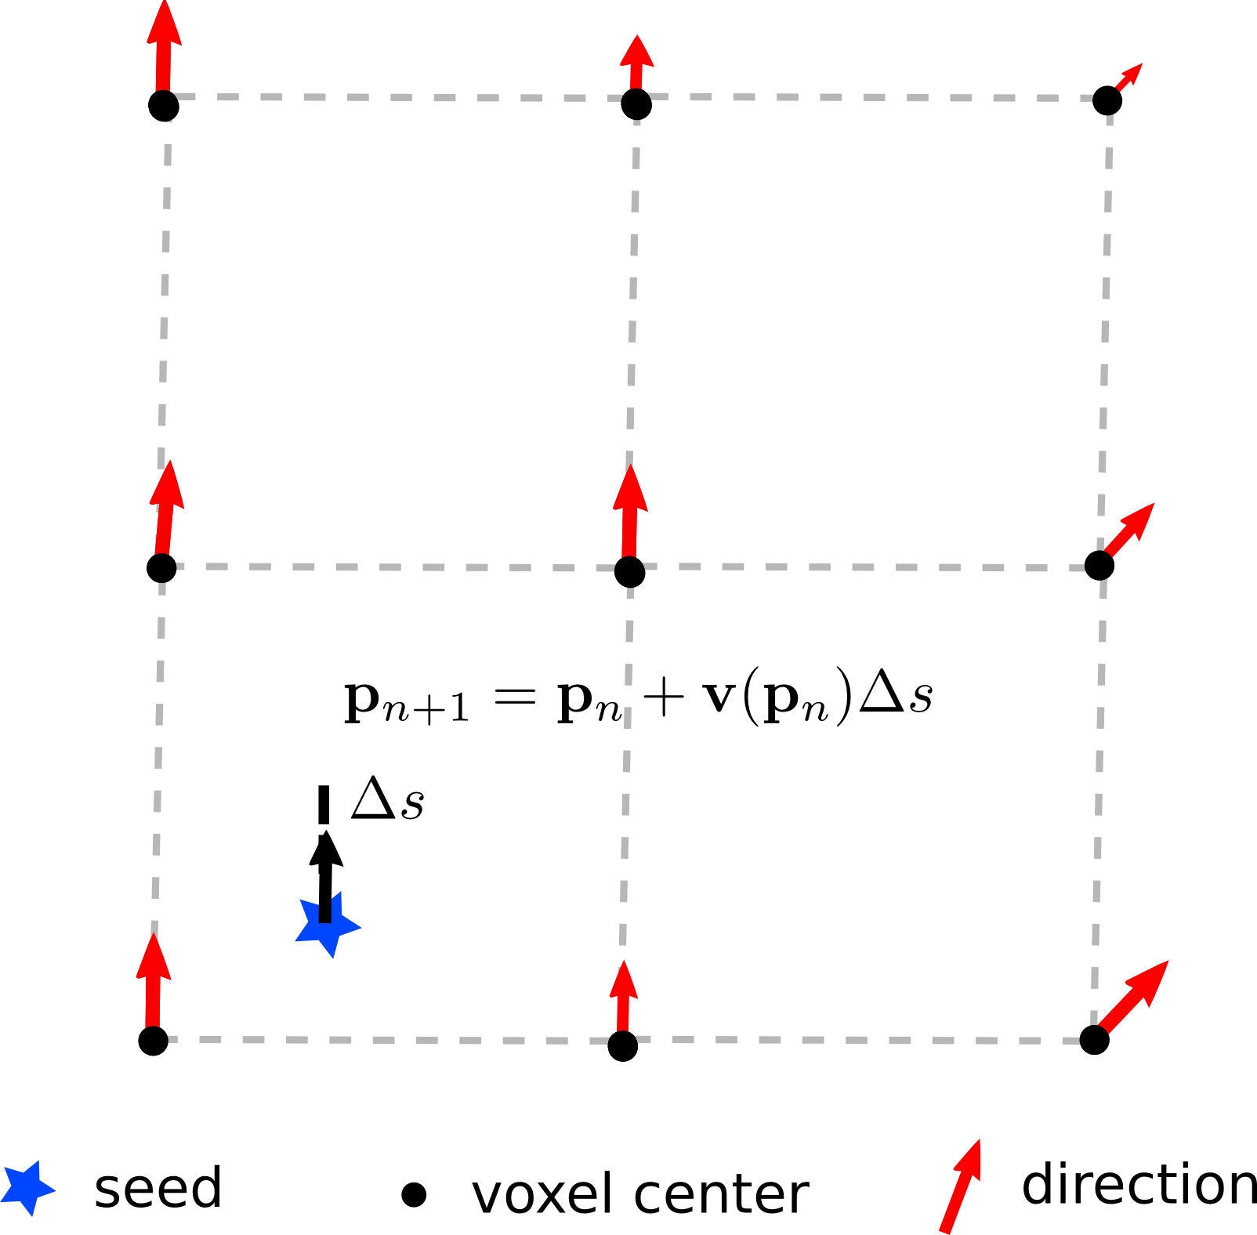
Euler Delta Crossings (EuDX)
E

Slide 13
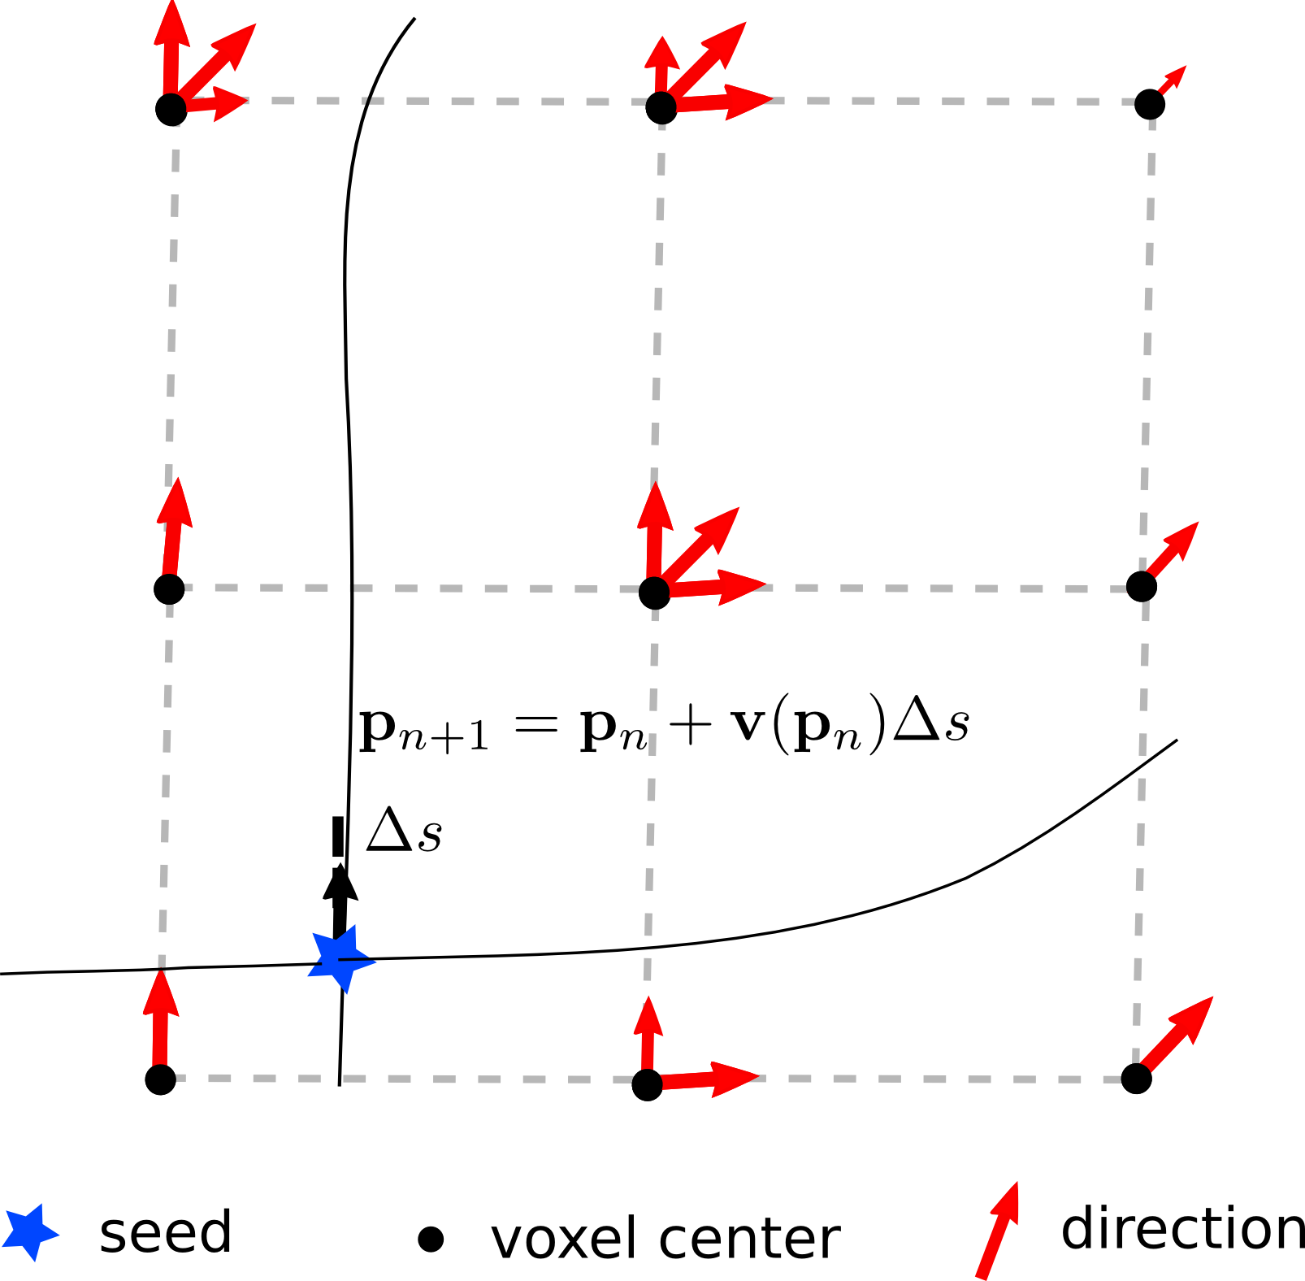
Euler Delta Crossings (EuDX)
E

Slide 14
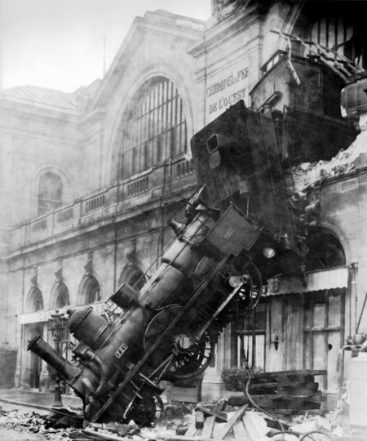
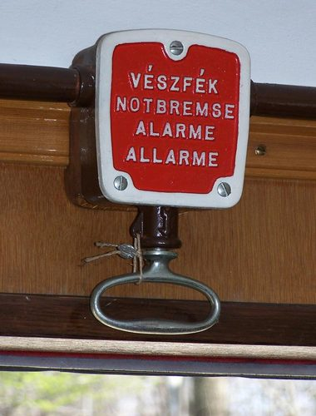
Stopping rules
How to stop streamlines ?
E

Slide 15
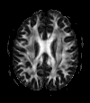
Stopping rules
How to stop streamlines ?
Level of Anisotropy
Start if FA > threshold and Stop if FA < threshold (FA ~0.15/0.20)
To avoid regions with low anisotropy (high noise effect and variability)
To avoid tracking in regions like CSF and GM
Angle of curvature
Fibers should not turn too sharply
Stop if the ANGLE between the old and new direction is > threshold
it depends on the algorithm used (e.g FACT vs Euler)
It depends on the resolution of your dataset
θ
E

Slide 16
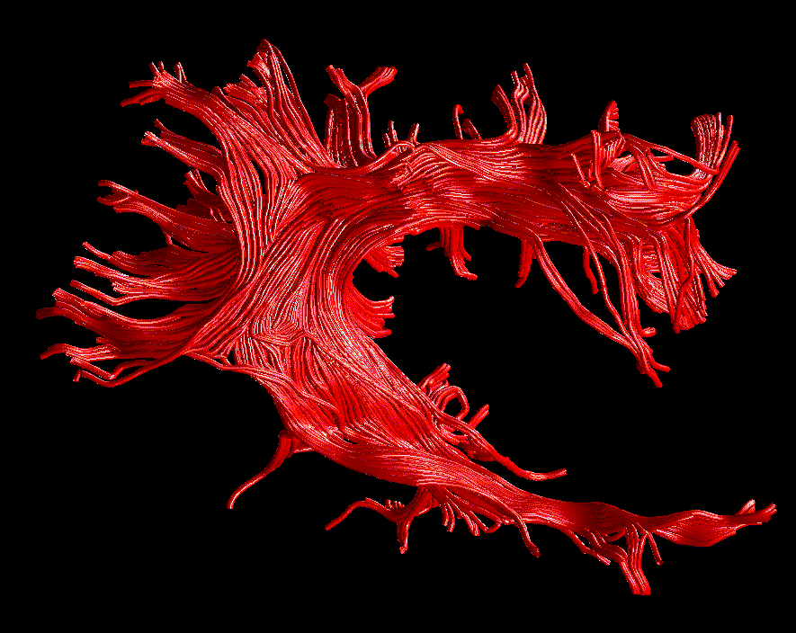
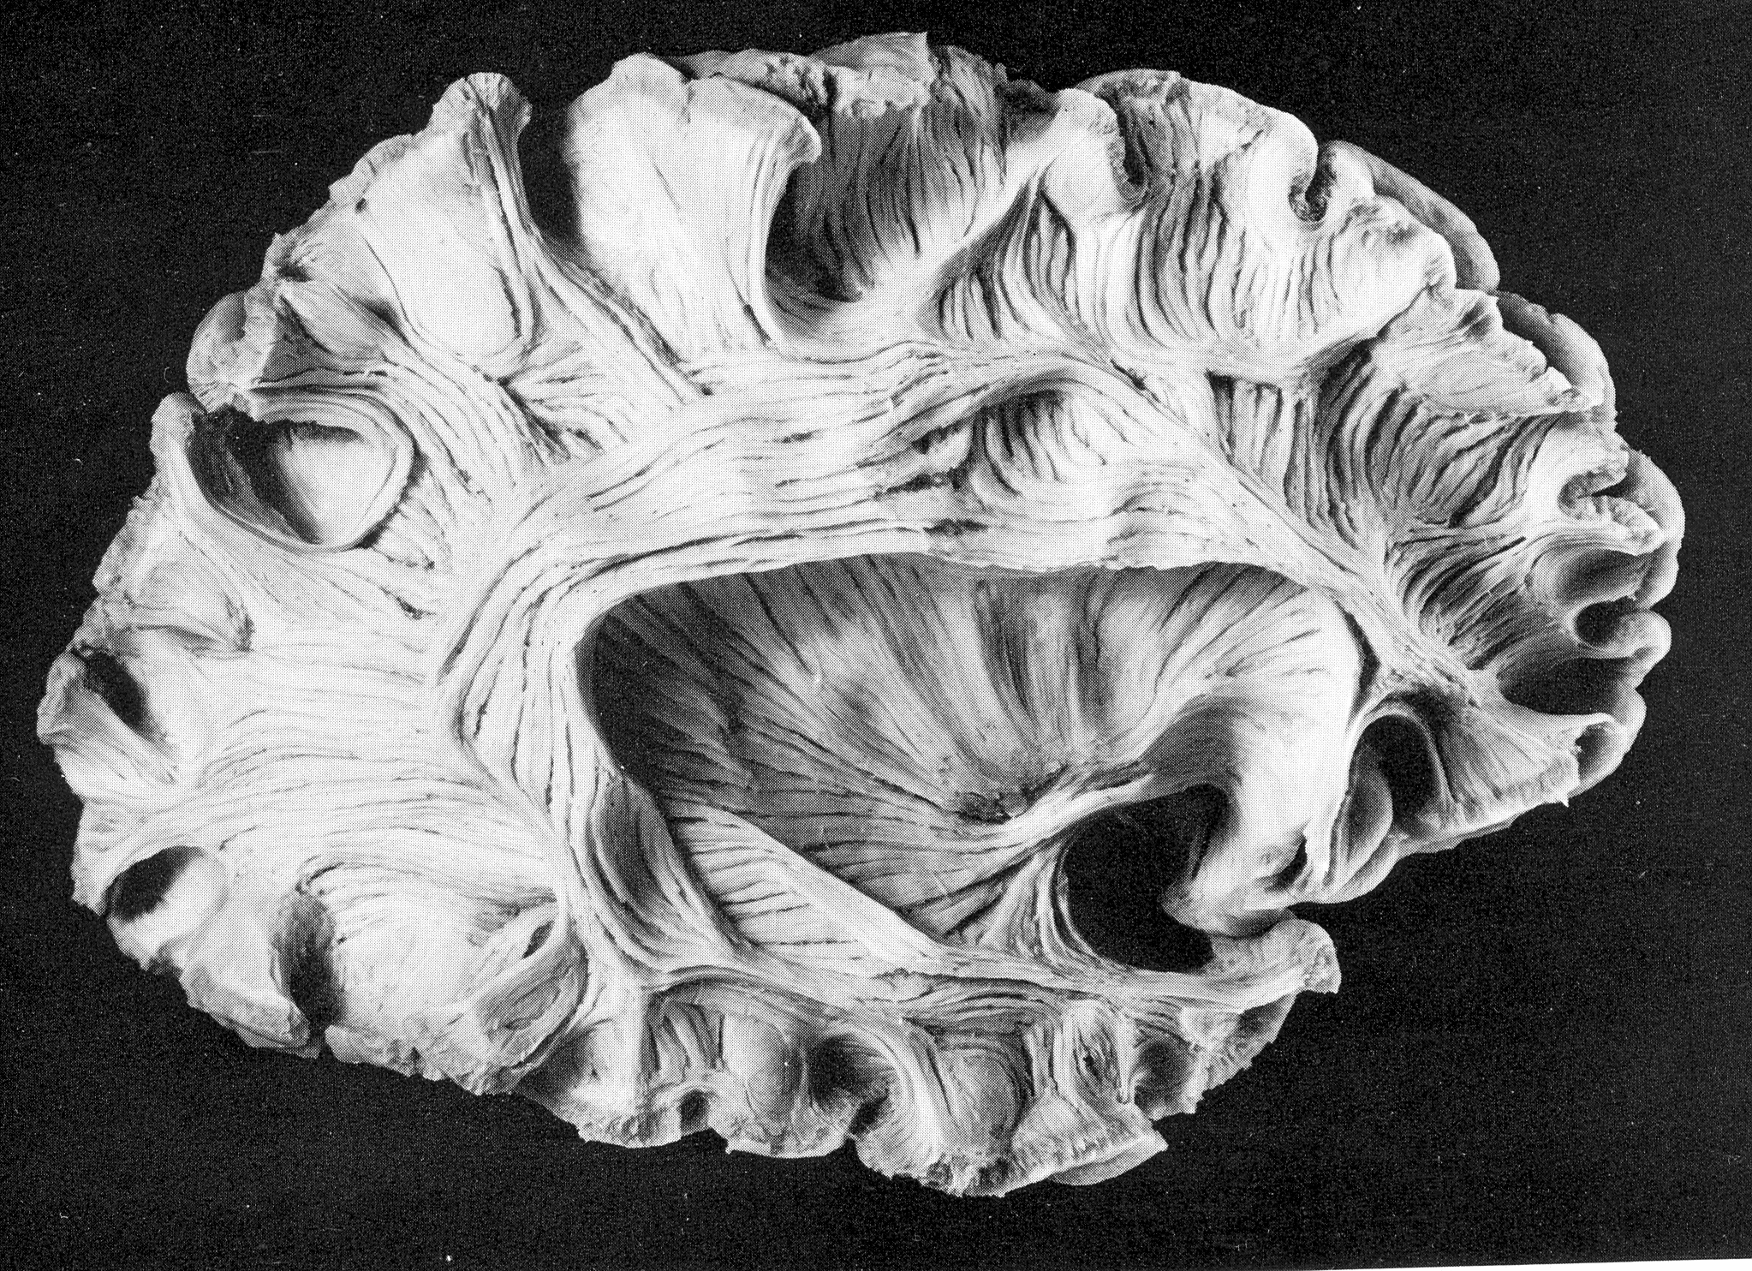
The result
Arcuate Fasciculus
SHORT FIBRES
LONG FIBRES
Virtual In-Vivo Dissection
Post-Mortem Dissection
Lights and Stream-tubes are used to obtain a better 3D visualization.
The size of the tubes is arbitrary and it doesn’t represent the real fascicles!
Catani et al. NeuroImage 2002

Slide 17
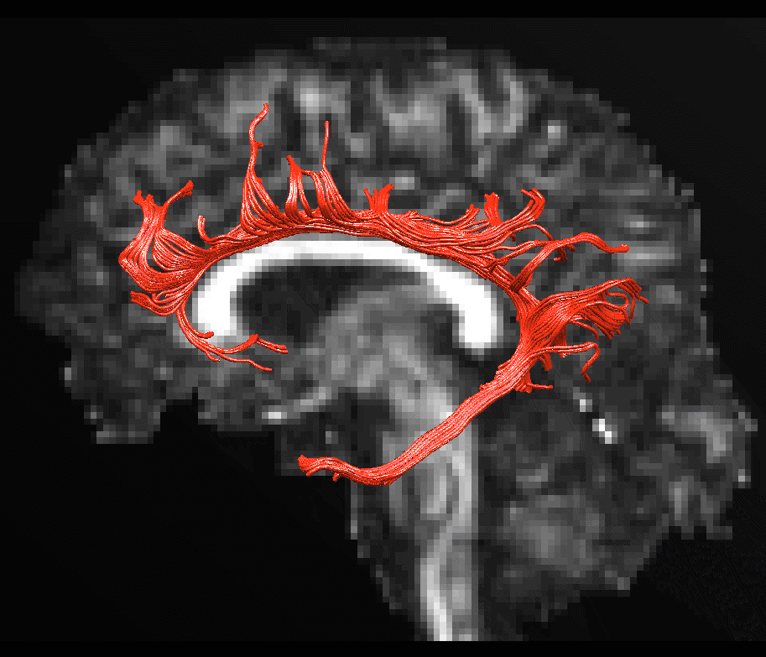
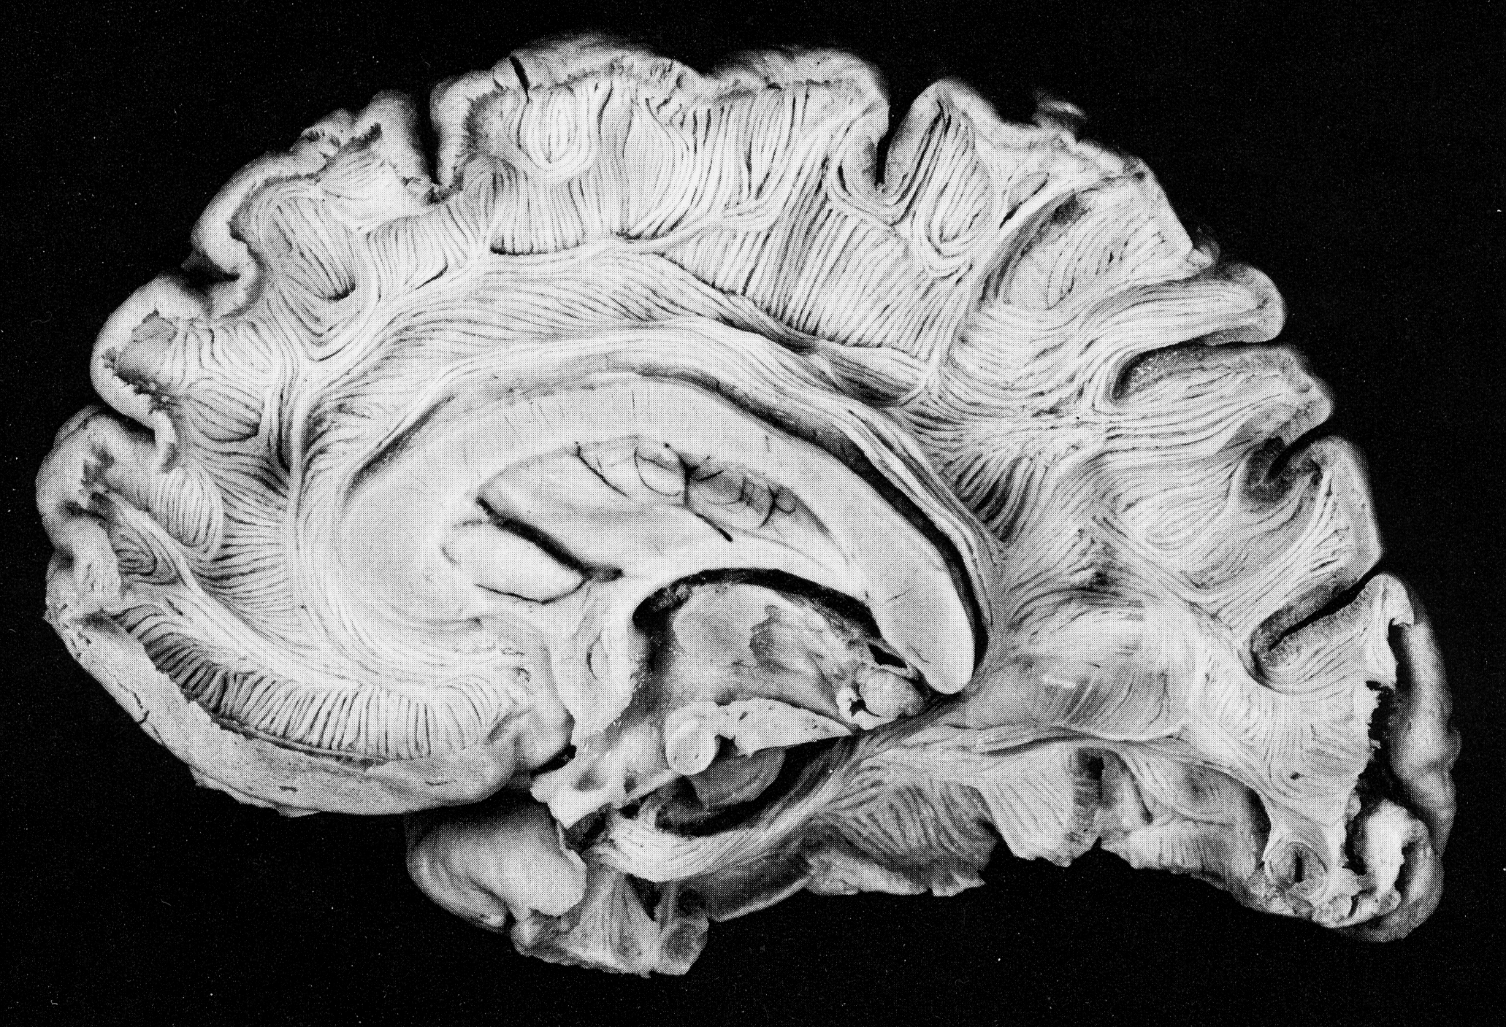
The result
Cingulum
SHORT FIBRES
FRONTAL FIBRES
PARIETAL FIBRES
LONG FIBRES
OCCIPITAL FIBRES
TEMPORAL FIBRES
Virtual In-Vivo Dissection
Post-Mortem Dissection
Lights and Stream-tubes are used to obtain a better 3D visualization.
The size of the tubes is arbitrary and it doesn’t represent the real fascicles!
Catani et al. NeuroImage 2002

Slide 18
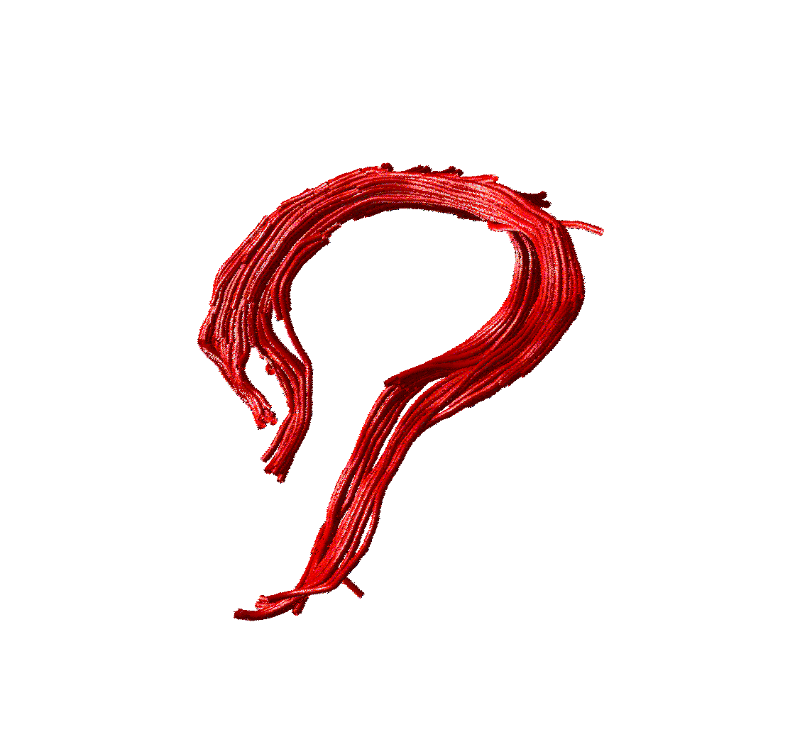
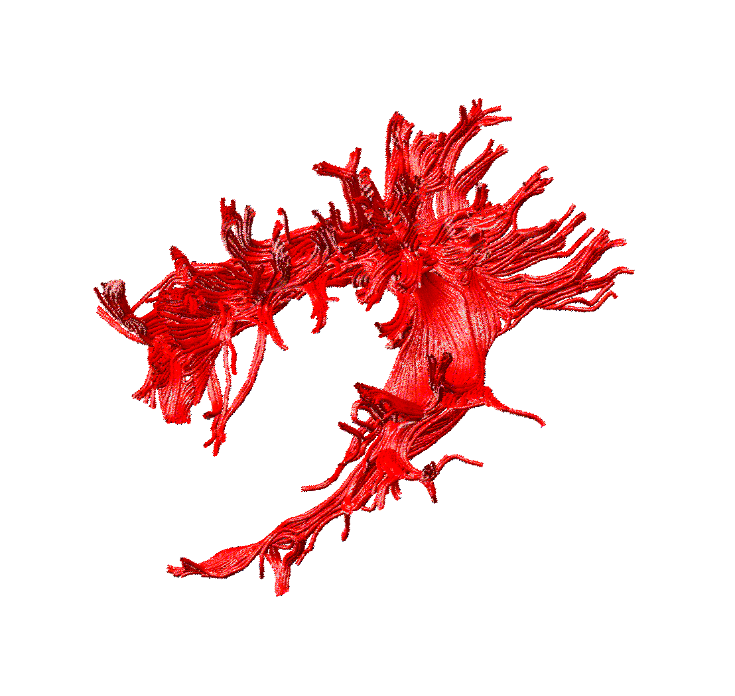
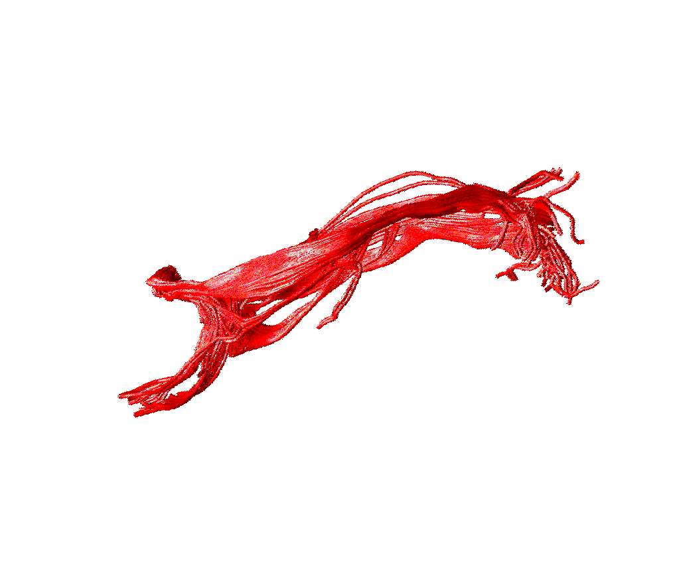
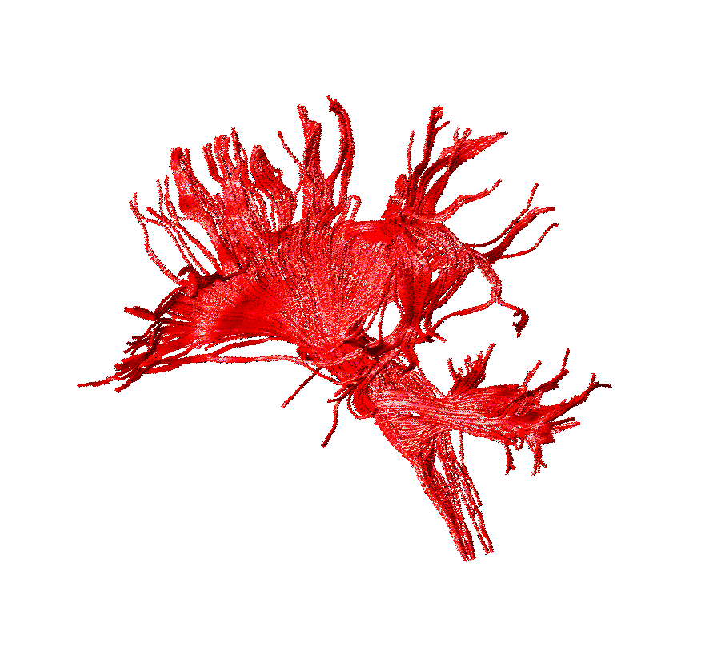
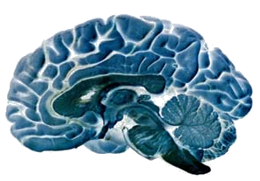
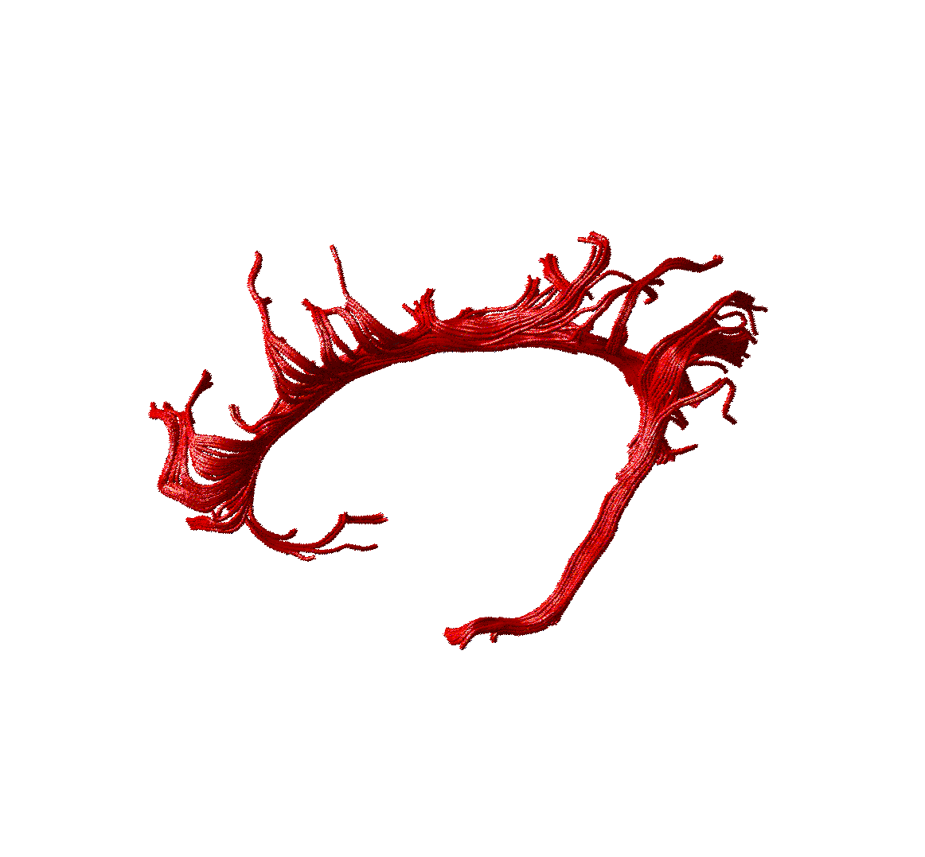
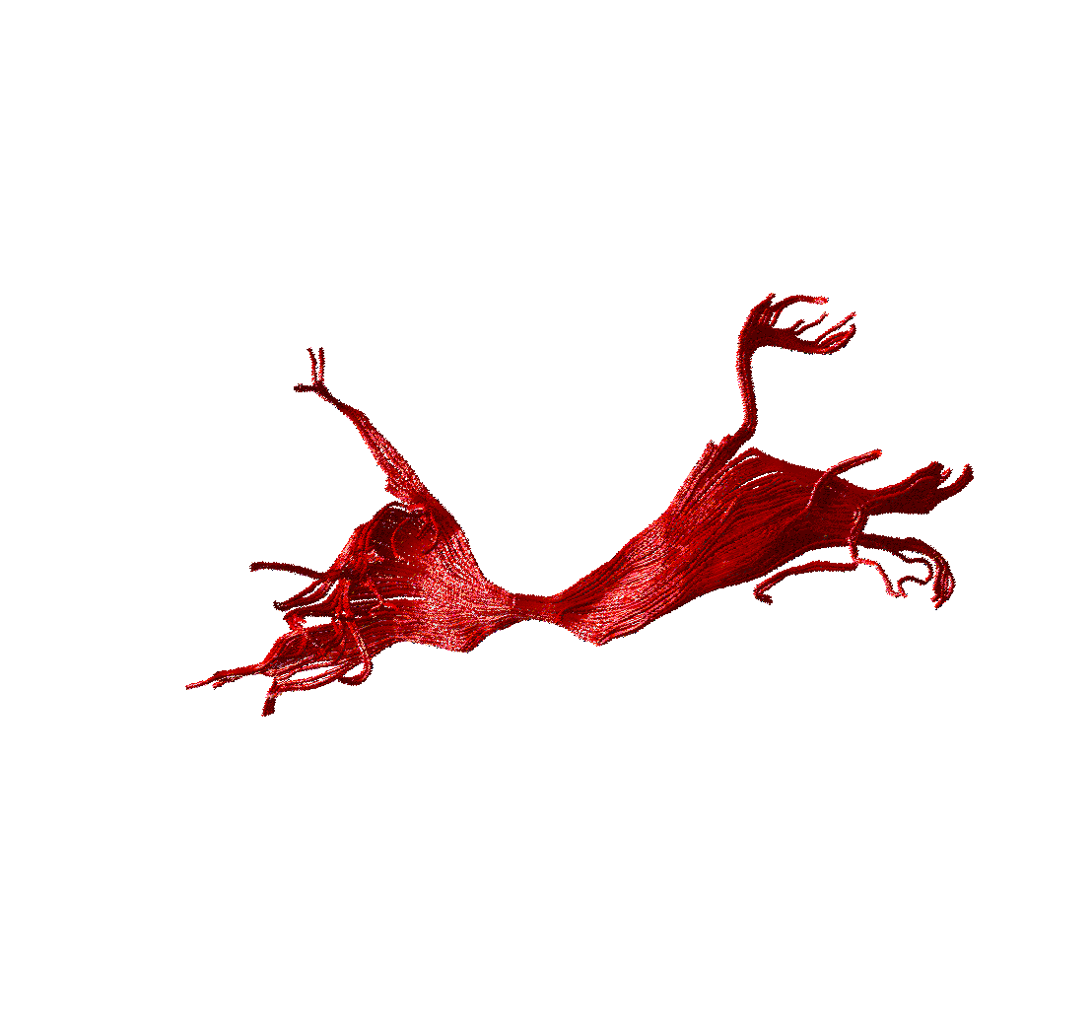
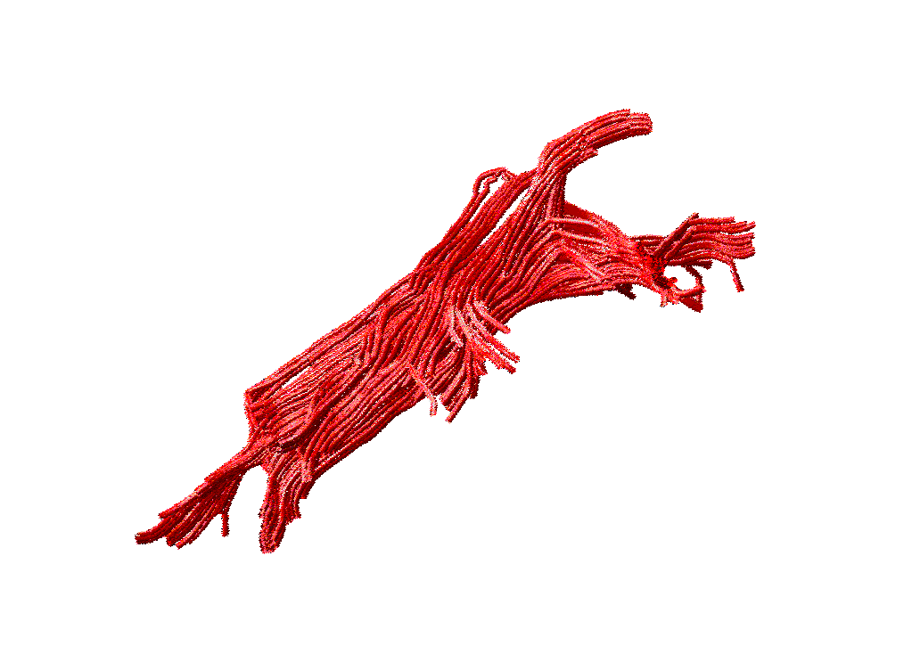
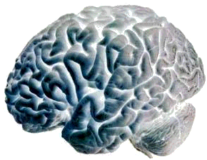
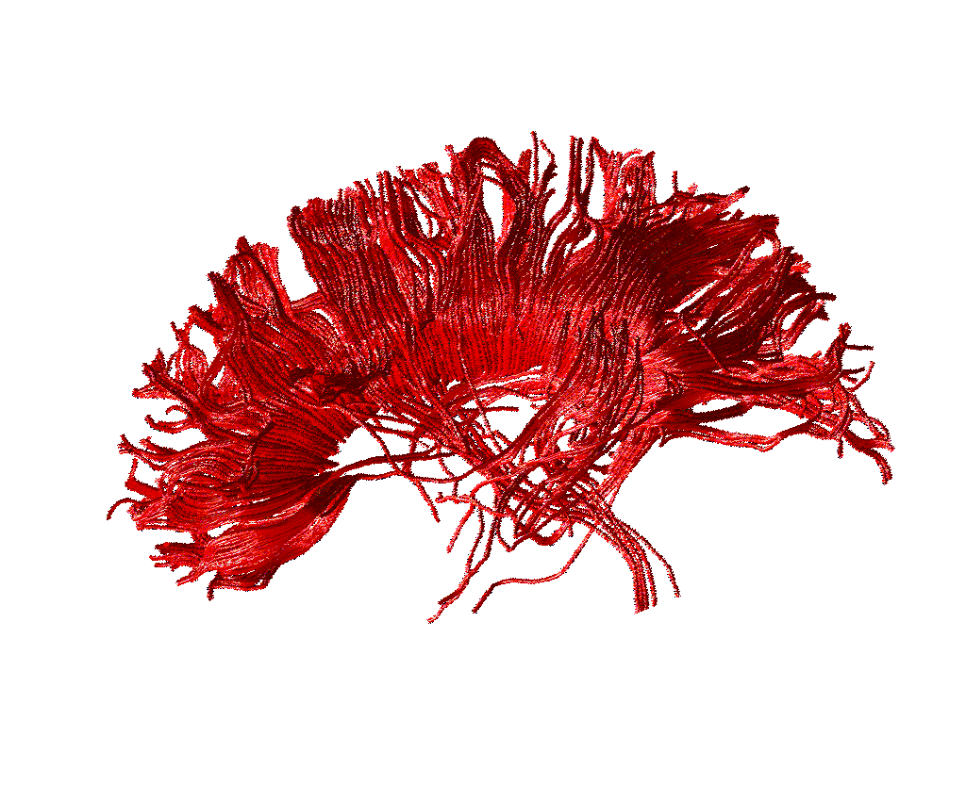
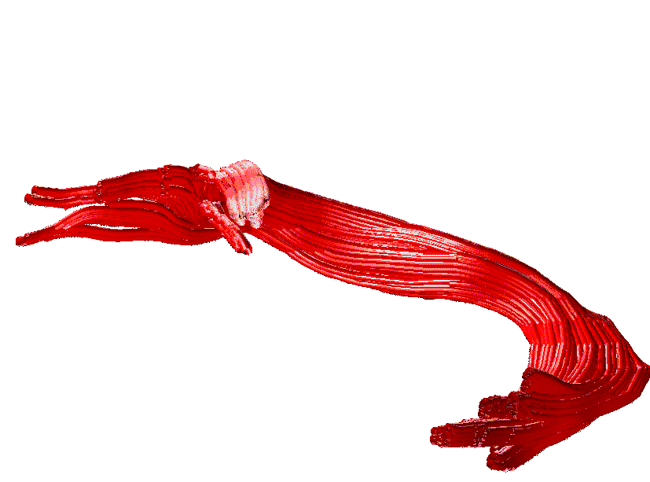
The expectation
ASSOCIATION
PROJECTION
Cingulum
Inferior longitudinal
Corona radiata
Fornix
COMMISSURAL
Arcuate
Uncinate
Inferior fronto-occipital
Corpus callosum
Anterior commissure
Courtesy of Flavio Dell’ Acqua

Slide 19
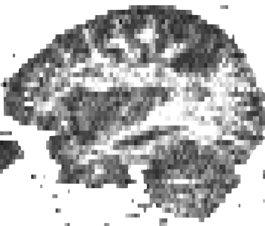
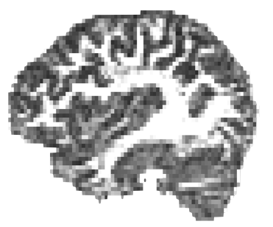
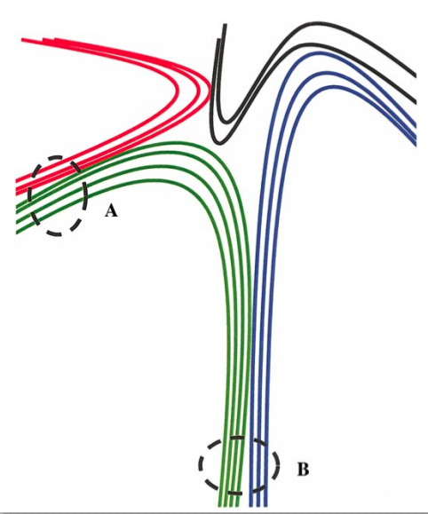
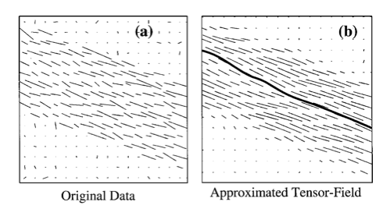
Data quality
low SNR
high SNR

Slide 20
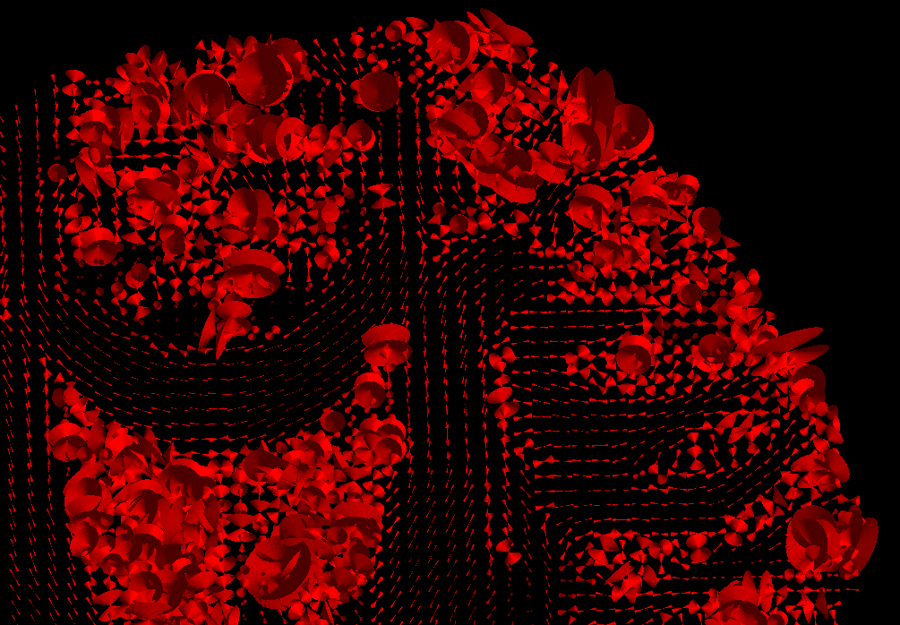
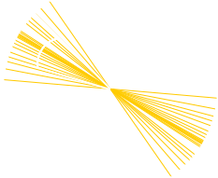
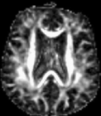
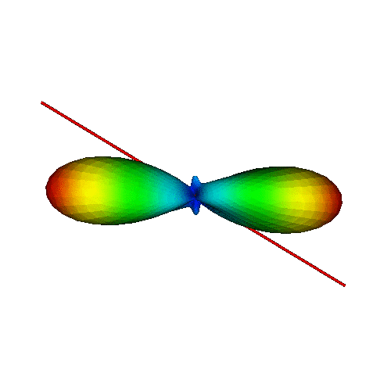
Orientation variability
Measuring variability
95% “cone uncertainty”
Courtesy of Derek Jones
Accounting for variability
Courtesy of Maxime Descoteaux

Slide 21
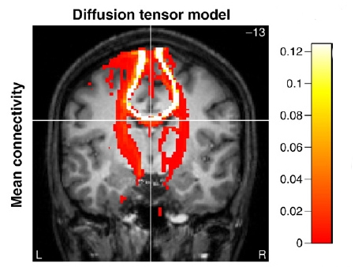
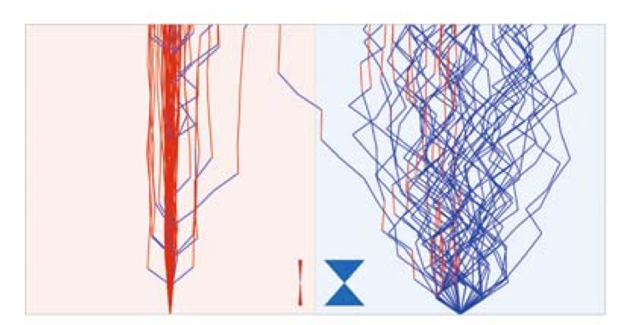
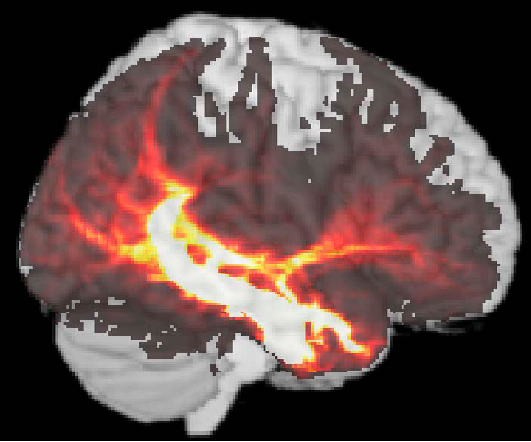
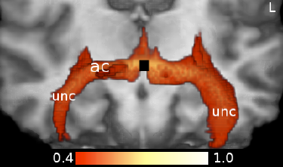
Probabilistic Tracking
Tractography is repeated multiple times from the same seed to map the intrinsic variability or uncertainty in the data.
Low Uncertainty
High Uncertainty
Kaden E et al.Neuroimage, 2007
PICO : Parker GJ, et al. MRM, 2003
The results are described a probability/connectivity” maps
The intensity represents the number of streamlines per voxel.
Descoteaux M et al. TMI, 2009

Slide 22
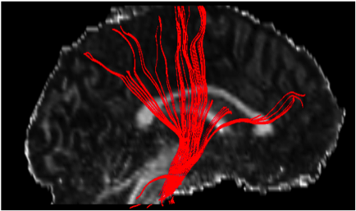
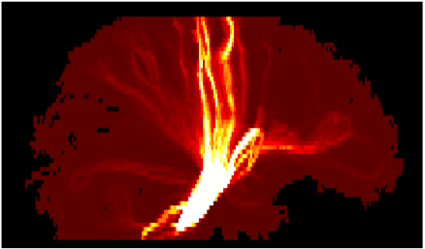

Probabilistic Tracking
Deterministic
Probabilistic
Low Reproducibility
High Reproducibility
Mapping the uncertainty is not mapping the anatomical probability

Slide 23
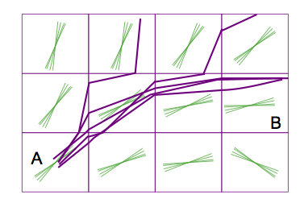
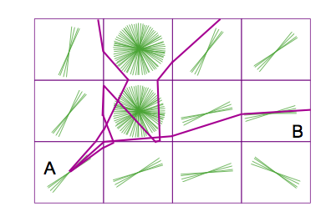
Probabilistic Tracking
Noisy datasets will show more →
Uncertainty
Courtesy of Flavio Dell’ Acqua

Slide 24
Things to remember
Tractography is not always commutative
- Tracking from A to B can be different from tracking from B to A !
Not all software performs tractography in the same way
Use all the brain as seed-regions and then ROIs are used to visualize only streamlines that pass inside them.
Others start tracking from a first ROI and then a second ROIs is used to “filter results”.
Dipy supports both.
Some software includes Boolean logic rules on tracks and ROIs (AND, OR, NOT) and other operators like CUT or SPLIT to remove “spurious” tracks

Slide 25
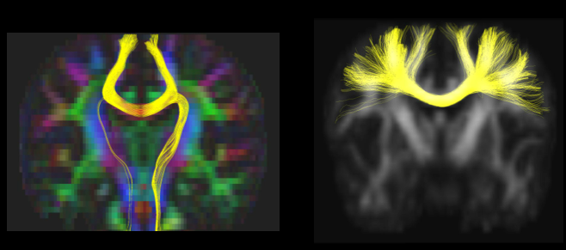
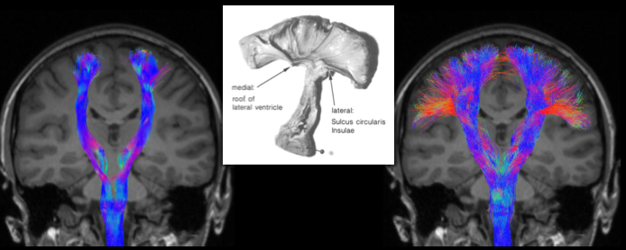
Multiple orientations/crossings
DTI
HARDI
DTI
HARDI

Slide 26
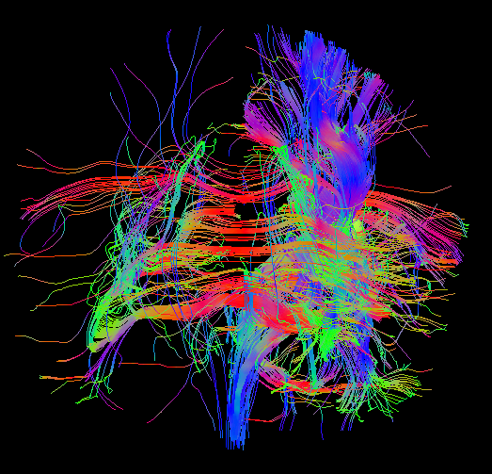
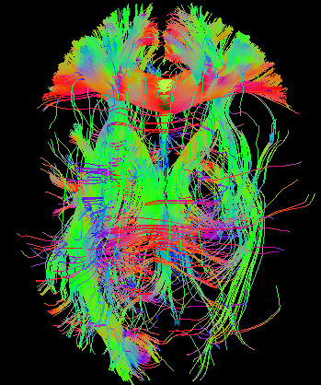
Multiple orientations/crossings
More fiber orientations to follow…
More changes to get it wrong.
For example, when a large angular threshold is used.

Slide 27
Applications
of tractography
and some issues

Slide 28

`
Neurosurgical planning
Neurosurgical planning
Brain tumor
M. Descoteaux, M. Chamberland and D.Fortin using the Fibernavigator which supports real-time tracking
https://github.com/scilus/fibernavigator
National geographic - February 2014

Slide 29


Automatic tract dissection
Tractography based analysis

Slide 30

Automatic tract dissection
Garyfallidis et al. Frontiers of Neuroscience 2012

Slide 31

Tractometry - group studies
FA₅
FA_{n-1}
FA₄
FA₃
FA₂
FA₁
Bells et al. ISMRM 2012, Assaf et al. Neuroimage 2013,
Catani et al, PNAS 2007, Lebel & Beaulieu HBM 2009, Forkel et al Brain 2014

Slide 32

Along length statistics
Yeatman PLoS 2010

Slide 33


Connectomics
Chamberland, Descoteaux et al., HBM 2014

Slide 34

Rely on counting?
Courtesy of Marco Catani

Slide 35





Validation
Wrong connections
False but plausible connections
> 50% of streamlines!
www.tractometer.org

Slide 36
Recent advances
in tractography

Slide 37

Reducing tractography biases
Masking, seeding, tracking parameters reduce the quantitative strength of comparing bundles of different length, position, width and curvature

Slide 38

White matter, gray matter, CSF priors for tracking
white matter
gray matter
CSF
Girard et al 2012, NeuroImage 2014,, Smith et al. NeuroImage 2012

Slide 39

Some results
Without anatomical priors (probabilistic tracking)
Girard et al Descoteaux NeuroImage 2014

Slide 40
Some results
With anatomical priors (probabilistic tracking)
Girard et al. Descoteaux NeuroImage 2014

Slide 41
Reducing tractography biases
Better seeding
reduces the length and curvature bias
Better management of boundaries
reduces length, volume and density biases
But don’t forget to register well your T1 to the diffusion data

Slide 42
What next?
Read the dipy paper [1].
Read tutorials in dipy.org
Read the code to understand in detail.
Run the tracking tutorials.
Check for evaluation results from the tractometer as they will be coming.
Literature overview see Garyfallidis and Stamatopoulos PhD theses.
[1] Garyfallidis et al. Frontiers in Neuroinformatics, 2014

Slide 43



Thank you
http://scil.dinf.usherbrooke.ca
http://tractometer.org

